Slide 1
Nature Of The Wind, Power In The Wind, Factors Influencing Wind, Wind Data And Energy Estimation,
SlideMake.com

Slide 2
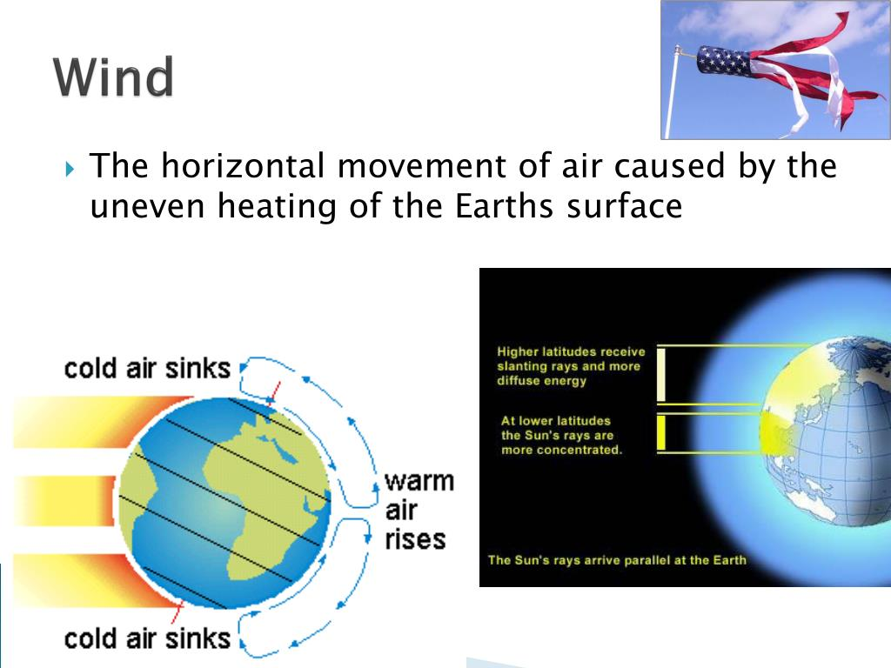
Nature of the Wind
Wind is the movement of air caused by differences in atmospheric pressure.
It is a renewable energy resource that is harnessed to generate electricity.
Wind is created by the uneven heating of the Earth's surface by the sun.
Notes:
Image source: https://www.slidemake.com/presentation/Nature-of-winds-64e78fe3aaec90be73c7ba70

Slide 3
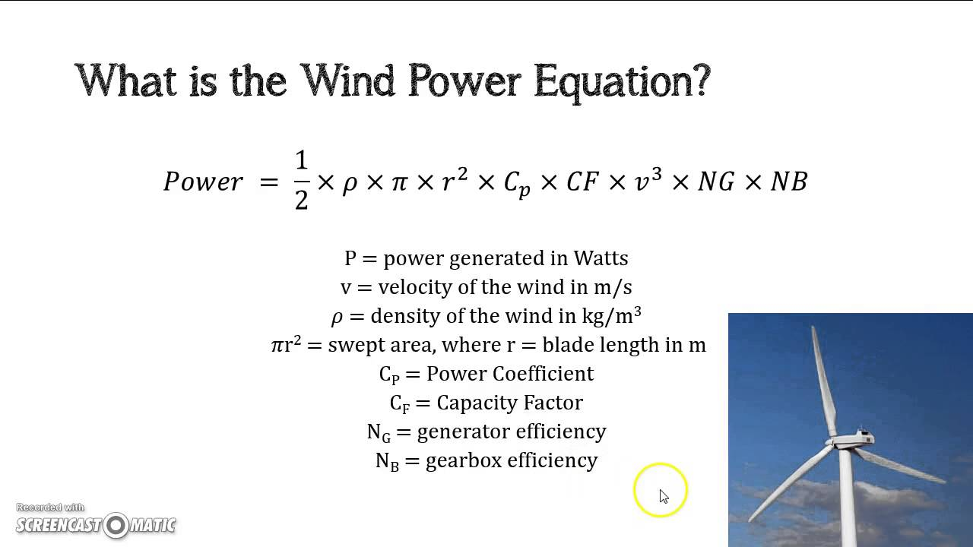
Power in the Wind
The power in the wind is derived from the kinetic energy of moving air.
Kinetic energy is proportional to the cube of the wind speed.
Power in the wind can be calculated using the equation: Power = 0.5 x air density x swept area x wind speed^3.
Notes:
Image source: https://www.youtube.com/watch?v=DO5PjuU8dXw

Slide 4
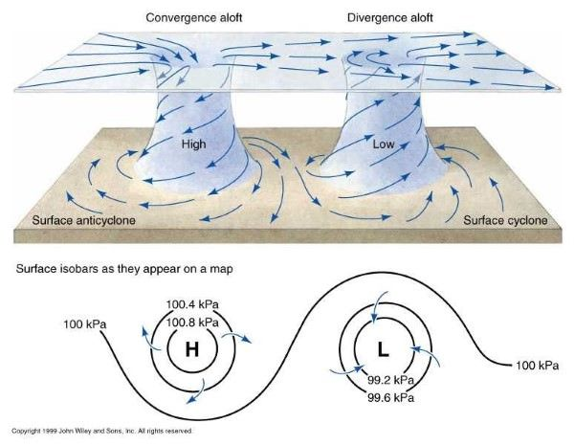
Factors Influencing Wind
Wind speed and direction are influenced by local topography.
Temperature gradients between land and water can affect wind patterns.
The Coriolis effect, caused by the Earth's rotation, influences wind direction.
Notes:
Image source: https://www.pinterest.com/pin/factors-affecting-wind-movement--370491506857600196/

Slide 5
Wind Data
Wind data is collected using anemometers, which measure wind speed.
Wind direction can be determined using wind vanes or windsocks.
Wind data is typically recorded over a period of time to analyze wind patterns.
Notes:
Image source: https://www.researchgate.net/figure/Data-collected-by-anemometers-at-a-height-of-60-cm-within-the-wind-barrier-and-outside-at_fig5_9076819

Slide 6
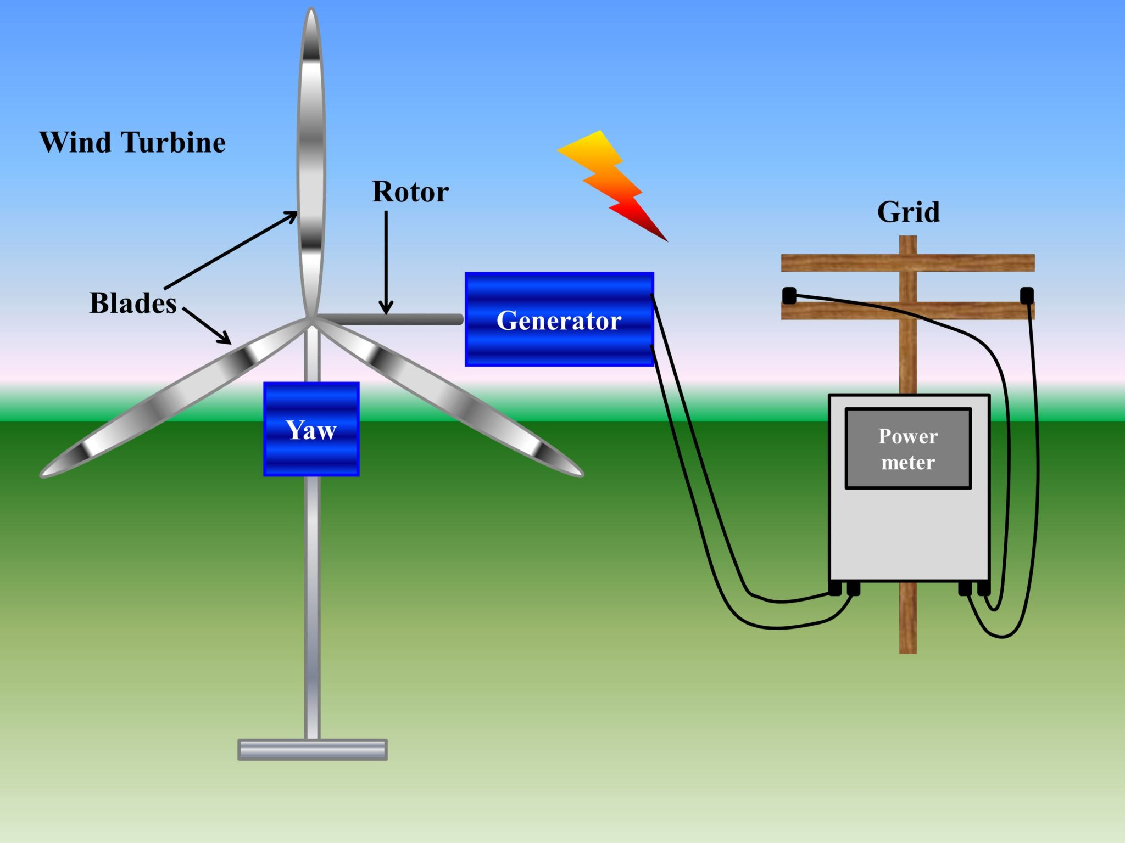
Wind Energy Estimation
Wind energy estimation involves predicting the potential energy output of a wind turbine.
Factors such as wind speed, air density, and turbine efficiency are considered in estimation.
Wind resource assessments are conducted to determine the suitability of an area for wind energy development.
Notes:
Image source: https://www.asrmeta.com/wind-energy-from-wind-turbine-components-and-efficiency/

Slide 7
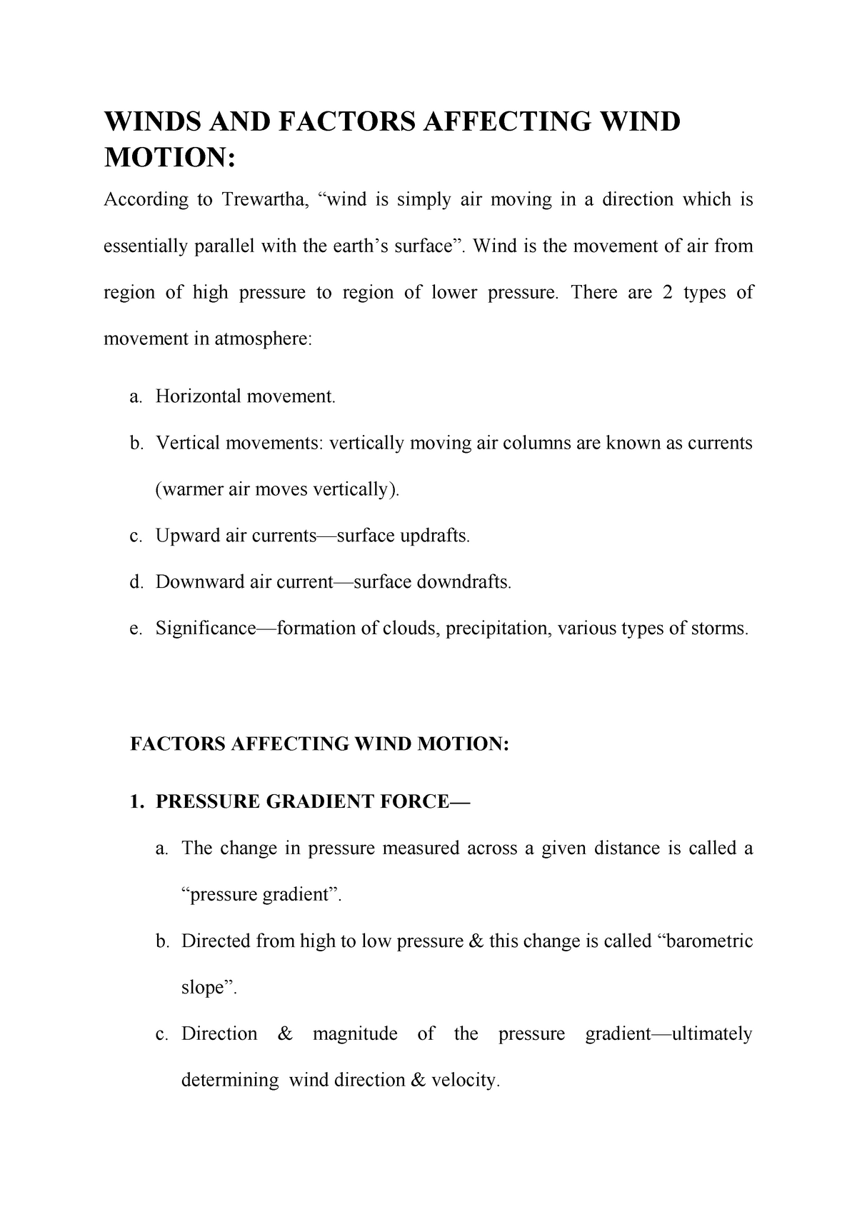
Factors Affecting Wind Energy Estimation
Wind speed variability affects the reliability of wind energy estimation.
Turbulence and wind shear can impact the performance of wind turbines.
Seasonal variations in wind patterns should be taken into account for accurate estimation.
Notes:
Image source: https://www.studocu.com/in/document/university-of-delhi/geography/winds-and-factors-affecting-wind-motion/3850383

Slide 8
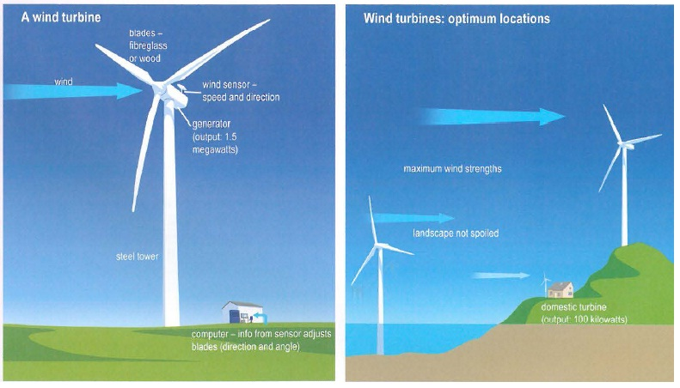
Wind Turbine Placement
Wind turbines are typically placed in areas with consistent and strong wind speeds.
Obstacles such as buildings or trees can create turbulence and reduce wind performance.
Proper spacing between turbines is necessary to minimize interference and optimize energy production.
Notes:
Image source: http://www.testbig.com/ielts-writing-task-i-essays/diagrams-below-show-design-wind-turbine-and-its-locationsummarise

Slide 9
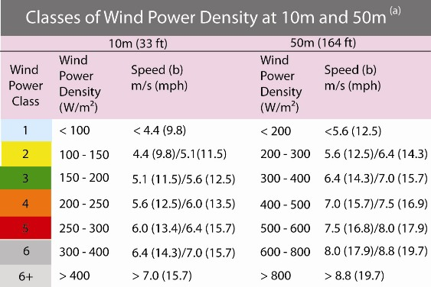
Wind Power Density
Wind power density is a measure of the available wind energy per unit area.
Areas with higher wind power density have greater potential for wind energy generation.
Wind power density is calculated using the equation: Power Density = 0.5 x air density x wind speed^3.
Notes:
Image source: https://www.codegreenhouston.org/wind-energy

Slide 10
Wind Speed Distribution
Wind speed distribution refers to the frequency of occurrence of different wind speeds.
Weibull distribution is commonly used to model wind speed distribution.
Understanding wind speed distribution helps in estimating the energy production of a wind turbine.
Notes:
Image source: https://www.wind-pioneers.com/wind-speed-frequency-distributions-challenge-to-wind-farm-developers/

Slide 11
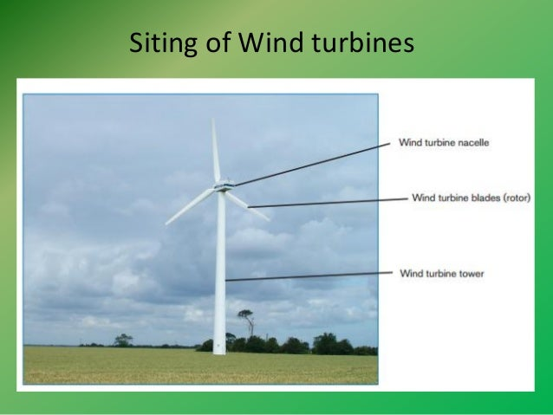
Wind Farm Siting
Wind farm siting involves selecting suitable locations for multiple wind turbines.
Factors such as wind resource, land availability, and grid connection are considered.
Environmental impacts and community engagement are also important in siting decisions.
Notes:
Image source: https://www.slideshare.net/himanshupaghdar/siting-and-planning-design-of-wind-turbines

Slide 12
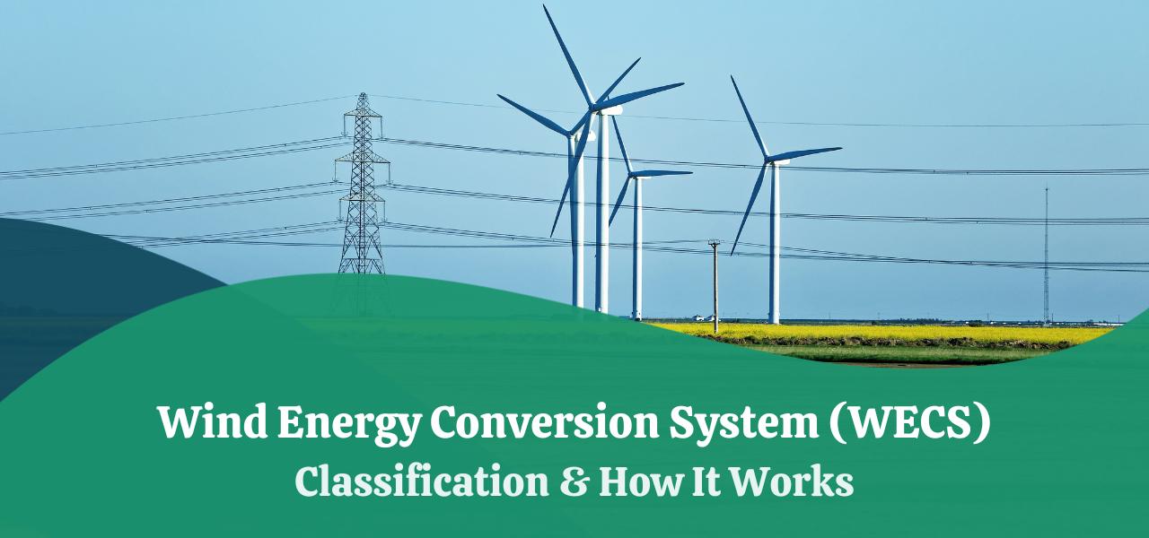
Wind Energy Conversion Systems
Wind energy conversion systems (WECS) convert wind energy into electrical energy.
Common WECS include horizontal-axis wind turbines and vertical-axis wind turbines.
WECS typically consist of blades, a rotor, a generator, and a control system.
Notes:
Image source: https://www.carboncollective.co/sustainable-investing/wind-energy-conversion-system-wecs

Slide 13
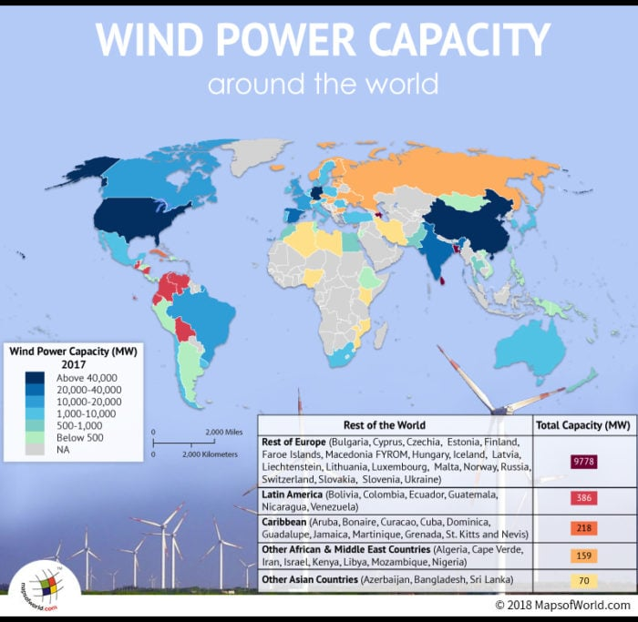
Wind Energy Potential
Wind energy potential varies across different regions and countries.
Countries with large land areas and coastal regions tend to have high wind energy potential.
Wind energy potential is assessed using wind resource maps and data analysis.
Notes:
Image source: https://www.mapsofworld.com/answers/environment/world-leader-wind-power-capacity/attachment/world-map-wind-power-capacity/

Slide 14
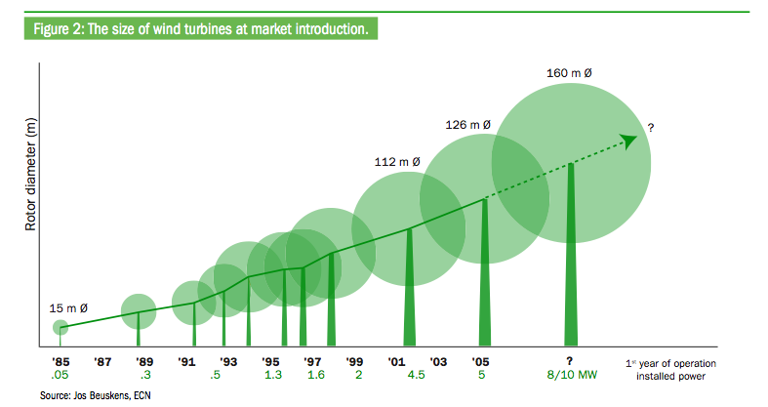
Wind Farm Performance
Wind farm performance is measured by the capacity factor, which represents the actual energy output compared to the maximum potential.
Factors such as turbine design, maintenance, and wind availability affect performance.
Regular monitoring and maintenance are crucial for optimizing wind farm performance.
Notes:
Image source: http://www.upsbatterycenter.com/blog/understanding-capacity-factor-wind-farms/

Slide 15
Wind Energy Integration
Wind energy integration refers to the integration of wind power into the existing electrical grid.
Challenges include variability and intermittency of wind power.
Advanced grid infrastructure and energy storage systems help in effective wind energy integration.
Notes:
Image source: https://www.asrmeta.com/wind-energy-from-wind-turbine-components-and-efficiency/

Slide 16
Economic Considerations
The cost of wind energy has significantly decreased in recent years.
Factors such as equipment costs, installation, maintenance, and financing influence the economics of wind energy.
Government policies and incentives play a crucial role in promoting wind energy development.
Notes:
Image source: https://chloeandmaddienergy.blogspot.com/p/step-2.html

Slide 17
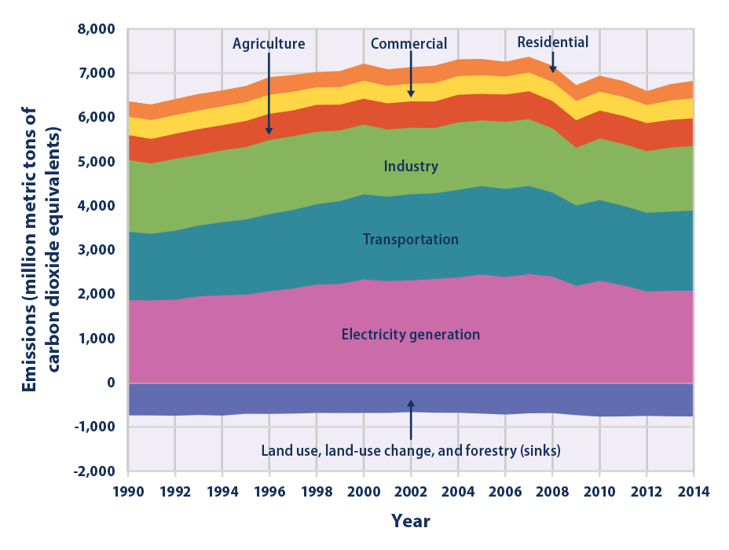
Environmental Impact
Wind energy has low greenhouse gas emissions compared to fossil fuels.
However, wind farms can have visual and noise impacts on local communities.
Proper environmental assessments and mitigation measures are important for sustainable wind energy development.
Notes:
Image source: http://climatechange.chicago.gov/climate-indicators/climate-change-indicators-us-greenhouse-gas-emissions

Slide 18
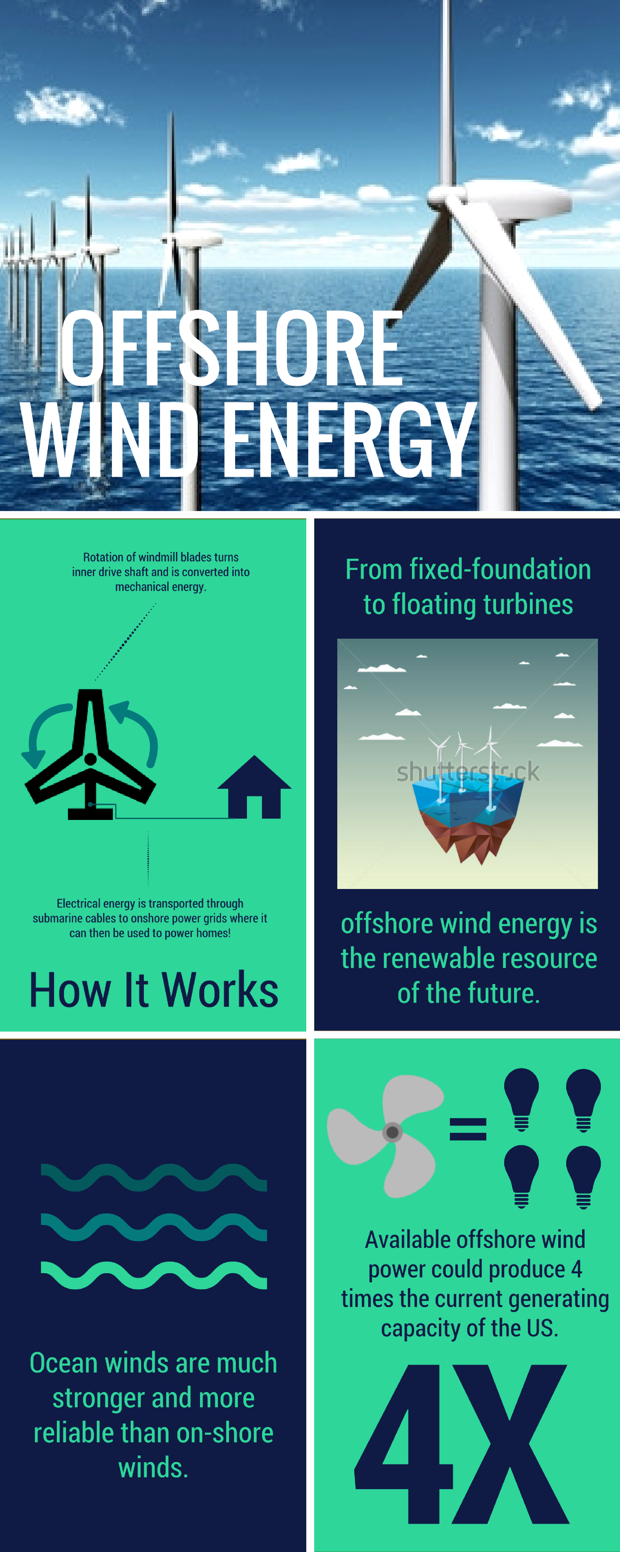
Offshore Wind Energy
Offshore wind energy has vast untapped potential.
Offshore wind farms can take advantage of stronger and more consistent winds.
Challenges include higher installation and maintenance costs compared to onshore wind farms.
Notes:
Image source: https://u.osu.edu/engr2367publicdocument/offshore-wind-energy/

Slide 19
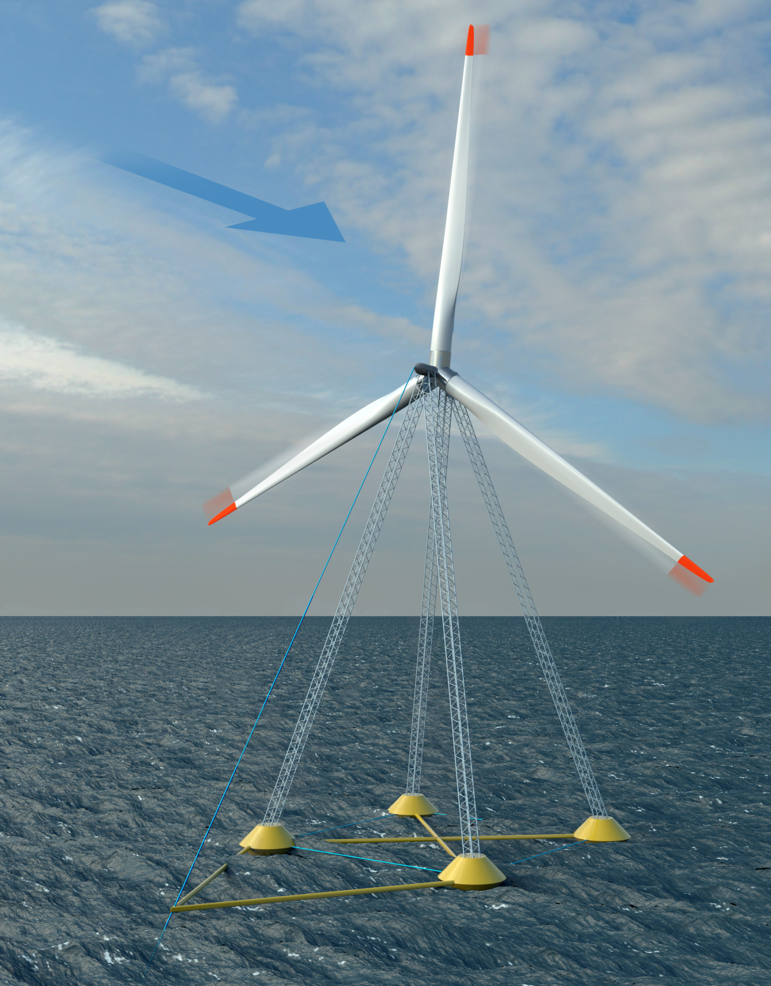
Future Trends
Advances in technology and research are leading to more efficient and larger wind turbines.
Floating wind farms and hybrid renewable energy systems are emerging trends.
Increased focus on energy storage and grid integration is expected in the future.
Notes:
Image source: https://coe.northeastern.edu/news/myers-awarded-masscec-grant-for-innovative-floating-wind-turbine/

Slide 20
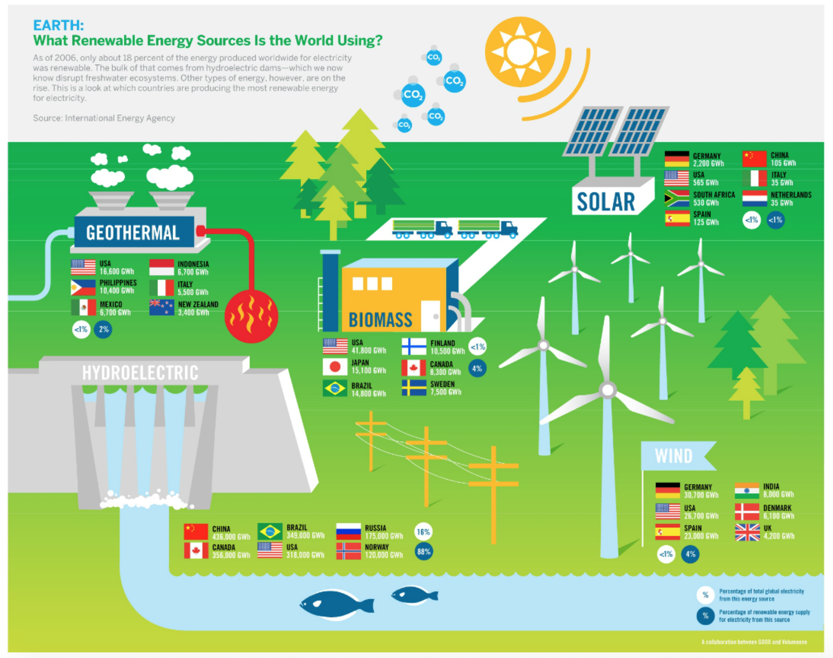
Conclusion
Wind energy is a valuable and renewable resource for electricity generation.
Accurate wind data and estimation techniques are essential for efficient wind energy projects.
Continued research and development are key to unlocking the full potential of wind energy.
Notes:
Image source: https://legendpower.com/news-events/the-state-of-renewable-energy/

